Slide 1
COMPARISON STRUCTURES

Slide 2
MAKE COMPARATIVE OR SUPERLATIVE FORMS ADDING ANY NECESSARY WORDS

Slide 3
I like Jack’s sense of humour. He’s ______________ (funny) man I’ve ever met.
His car’s as_________________ (expensive) ours.
Sarah’s height is 176 cm. She’s _____________ (tall) girl.
Those jeans looked far______________(modern) these ones.
__________(little) she eats,___________(angry) she gets.
This house is by far__________________(old) building in the city.
the funniest
expensive as
quite a tall
more modern than
the less
the angrier
the oldest

Slide 4
older
Each year I’m getting______ (old) and ______ (old).
If you don’t study hard, you won’t get_________ (smart).
I don’t think we have__________money to afford this trip.
I use one of my bedrooms________ an office.
This book is a great deal__________________ (helpful) that one.
Stop acting_________ a fool.
_____a doctor, he’s excellent. You’ll hardly ever find a specialist______him.
older
any smarter
enough
as
more helpful than
like
As
like

Slide 5
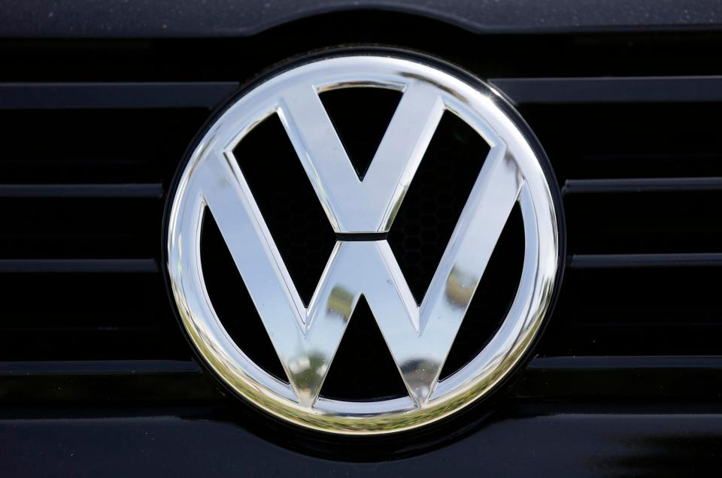
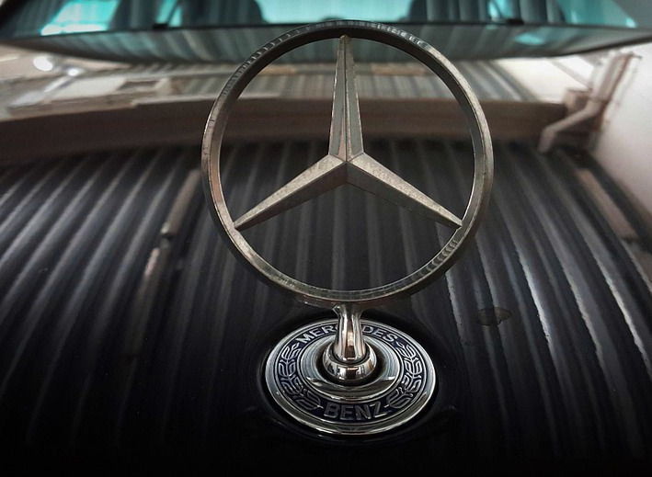
COMPARE THE FOLLOWING THINGS
VOLKSWAGEN | MERCEDES

Slide 6
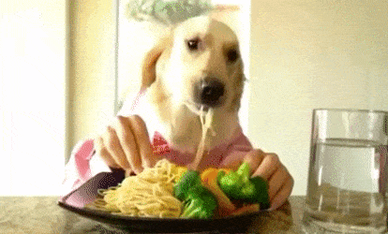
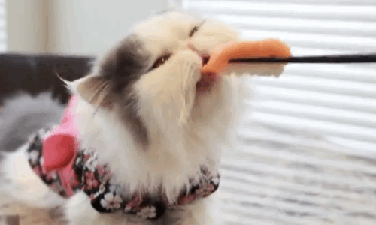
COMPARE THE FOLLOWING THINGS
ITALIAN FOOD | JAPANESE FOOD

Slide 7
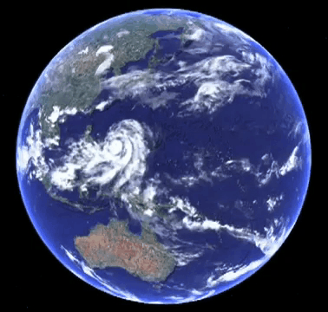
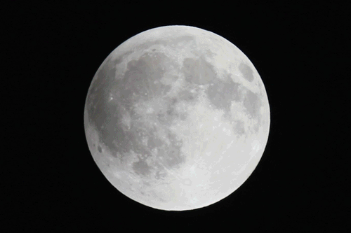
COMPARE THE FOLLOWING THINGS
THE EARTH | THE MOON

Slide 8
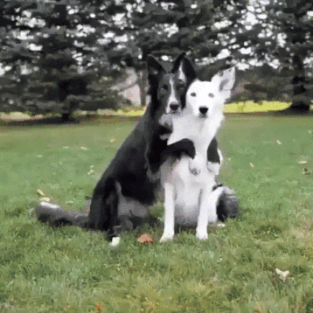
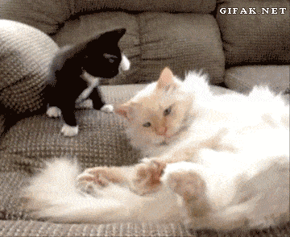
COMPARE THE FOLLOWING THINGS
CATS | DOGS

Slide 9
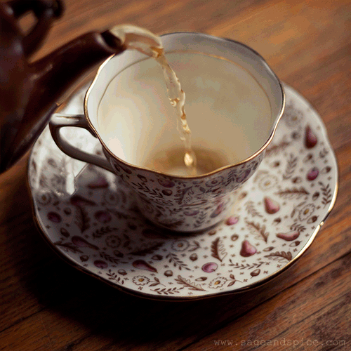
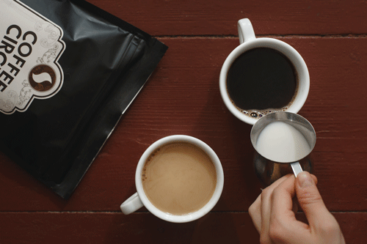
COMPARE THE FOLLOWING THINGS
TEA | COFFEE

Slide 10
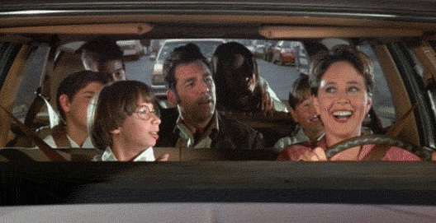
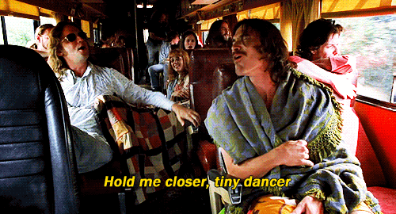
COMPARE THE FOLLOWING THINGS
TRAVELLING BY CAR | TRAVELLING BY BUS

Slide 11
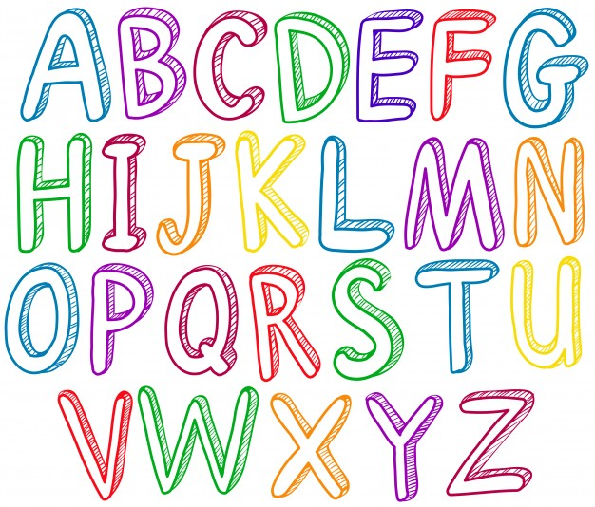

COMPARE THE FOLLOWING THINGS
ENGLISH | RUSSIAN

